Slide 1



Research Portfolio
By: Jack Peeples

Slide 2
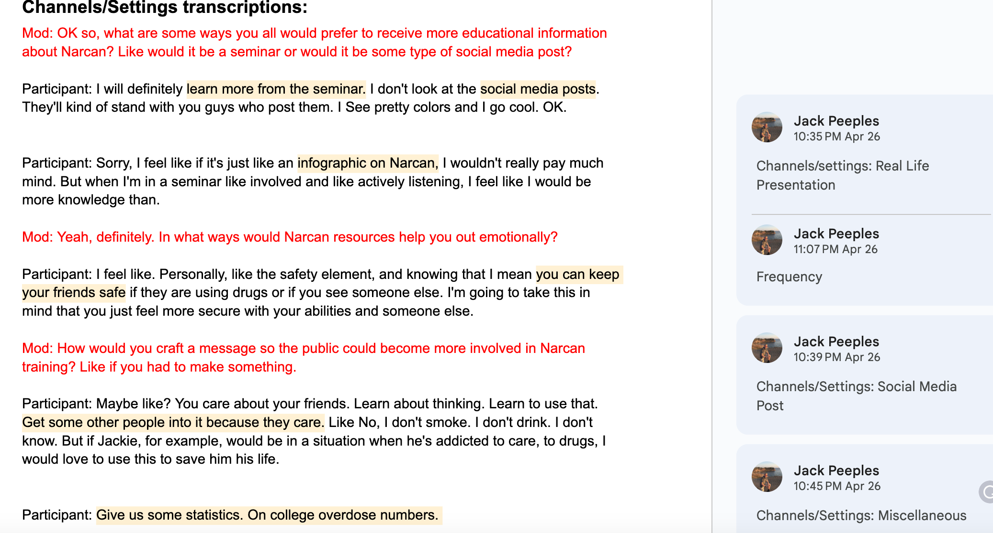
Focus Group-Increasing involvement or attendance with Narcan training on campus
In the focus group team, I practiced qualitative research by preparing a transcript with questions relevant to the topic of Narcan training. Our team conducted two focus groups asking UO students for their opinions about Narcan training on the college campus. From there, we could code each section based on the responses.

Slide 3
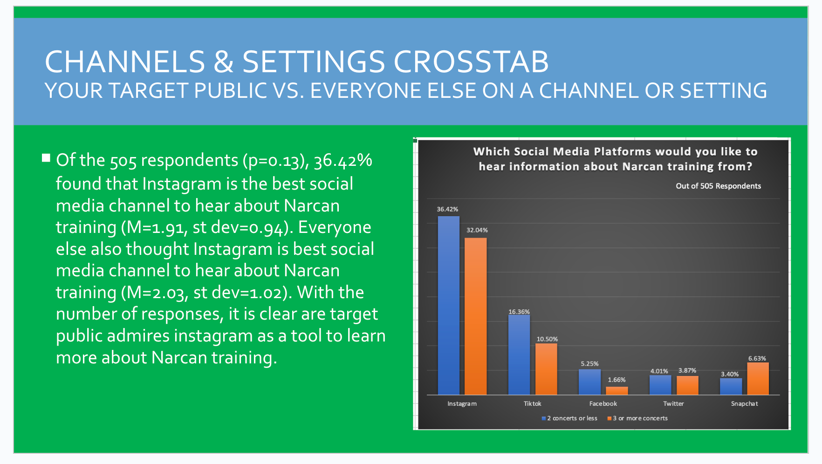
Survey-Increasing Involvement or attendance with Narcan training on campus
In the survey team, I convinced 10 UO students to take a survey about Narcan training. After every student got their 10 respondents to complete the survey, My team and I used Qualtrics to create a single-item and crosstab analysis for each section of the survey. I was responsible for creating a single-item and crosstab analysis for the channels and settings section. After working with this team, I have become proficient in conducting surveys and using Qualtrics for quantitative analysis.

